Slide 1


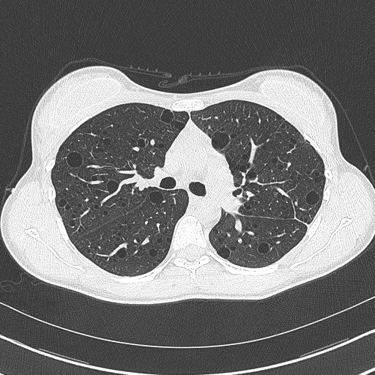

Simon Johnson
LAM: symptoms, screening, assessment and treatment
Nottingham University Hospitals
NHS Trust
National Commissioning Group
For Highly Specialised Services
National Centre for Lymphangioleiomyomatosis

Slide 2

LAM basics
What is LAM
How LAM effects the lungs and lymphatics
Symptoms & screening
How LAM progresses / monitoring
What treatments are available
The UK LAM Centre

Slide 3
Why the long name?
lymph
angio
leiomyo
matosis
a disease
lymphatics
vessels
smooth muscle
sporadic LAM
TSC-LAM

Slide 4
How common is LAM in TS?
Very rare in children
Women prevalence increases with age
  10% by 20 years
  80% by 40 years
  Many don’t have symptoms
Men may get lung cysts
  virtually never have symptoms

Slide 5
Why does LAM only affect women?
LAM cells respond to oestrogen
  grow more quickly
  spread around the body
Oestrogen is probably bad for LAM
  oestrogen containing medicines
  pregnancy
  LAM slows down after the menopause

Slide 6
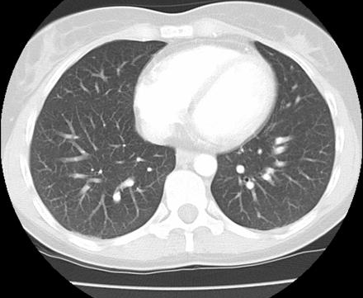
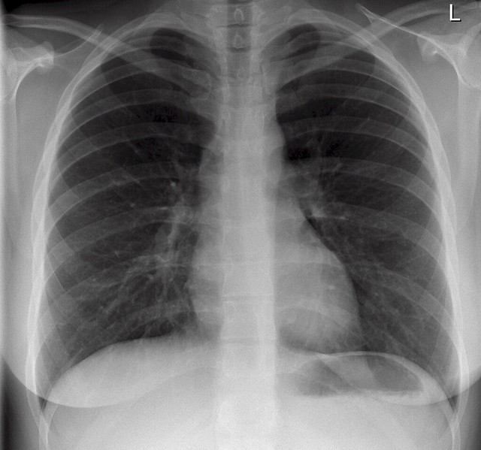
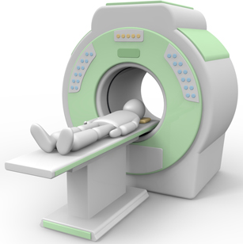
LAM X-rays & CT Scans
Sternum
Heart
Right lung
Left lung
Spine
Scanner
table

Slide 7
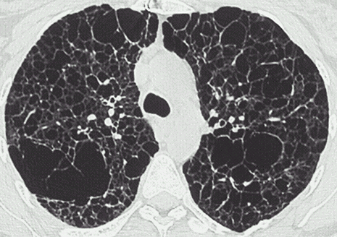

LAM X-rays & CT Scans

Slide 8
LAM related problems

Slide 9
Symptoms in LAM
Maybe none
Breathlessness
Wheezing
Cough
  chest infections
Abdominal bloating, swelling, discomfort
Fatigue
A lot of illnesses can
cause these symptoms

Slide 10
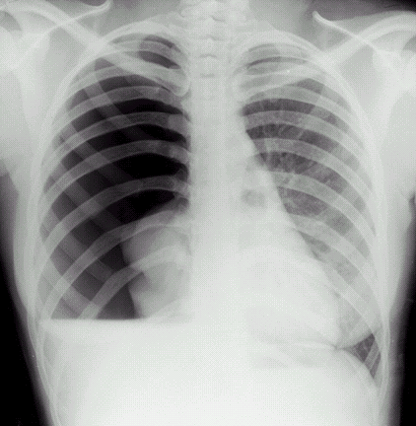
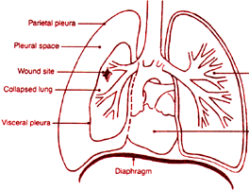
Pneumothorax (collapsed lung)
cysts can leak air causing pneumothorax
pneumothorax in LAM can be difficult to treat
heart

Slide 11
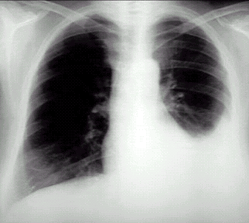
Chylous effusion
LAM cells can block lymph flow
in the lung and other lymph channels

Slide 12
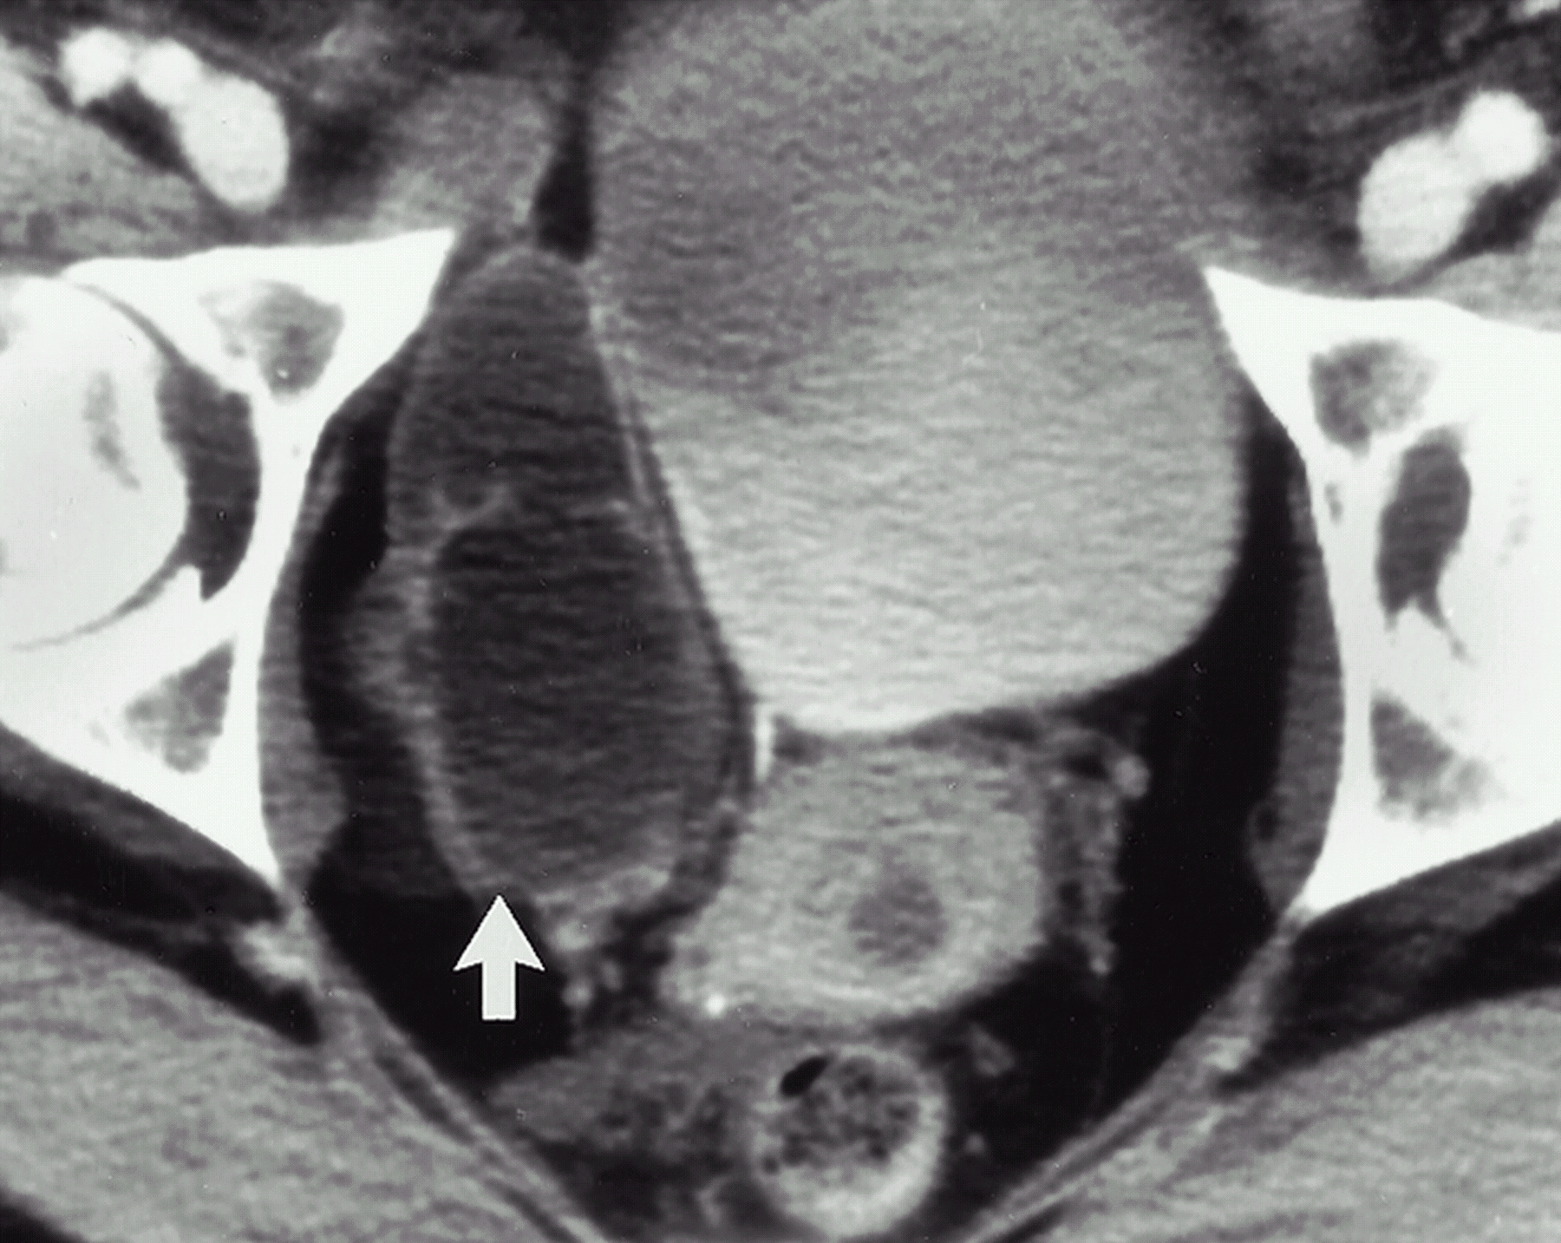
Abdominal LAM
2/3 have enlarged abdominal lymphatics
most don’t cause symptoms
lymphangioleio-myomas

Slide 13
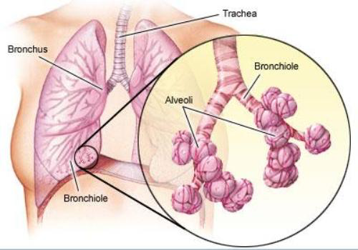
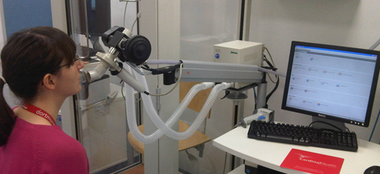
Assessing LAM severity:
Lung function tests
Airways move air into the alveoli
Alveoli mix air and blood
  Take up oxygen
  Remove waste CO₂
LAM affects airways and alveoli differently
Need different tests

Slide 14
How bad is my LAM?
age
lung function
previous history
other LAM issues
cyst burden
exercise hypoxemia
symptoms
your LAM

Slide 15
How should I be monitored?
If you don’t have LAM
Medical review
  ask about lung symptoms
CT scan
  if symptoms develop
  or every 5 to 10 years
If you have LAM
Medical review
  3 months to 1 year
Lung function
  FEV₁ & TL_{CO}
As required
  pneumothorax
  infections

Slide 16
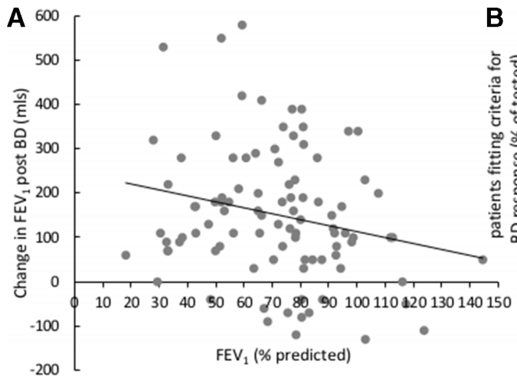
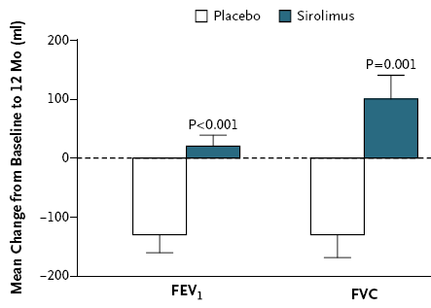

Should I have drug treatment for LAM?
Bronchodilators
  (e.g. salbutamol)
  may reduce breathlessness
Rapamycin (sirolimus)
  reduces decline in lung function
  reduces angiomyolipoma size
Being tested
  Statins, chloroquine, Saracatinib, metformin……..
Johnson & Johnson Thorax 2019
McCormack et.al. NEJM 2011
McCormack et.al. NEJM 2011

Slide 17
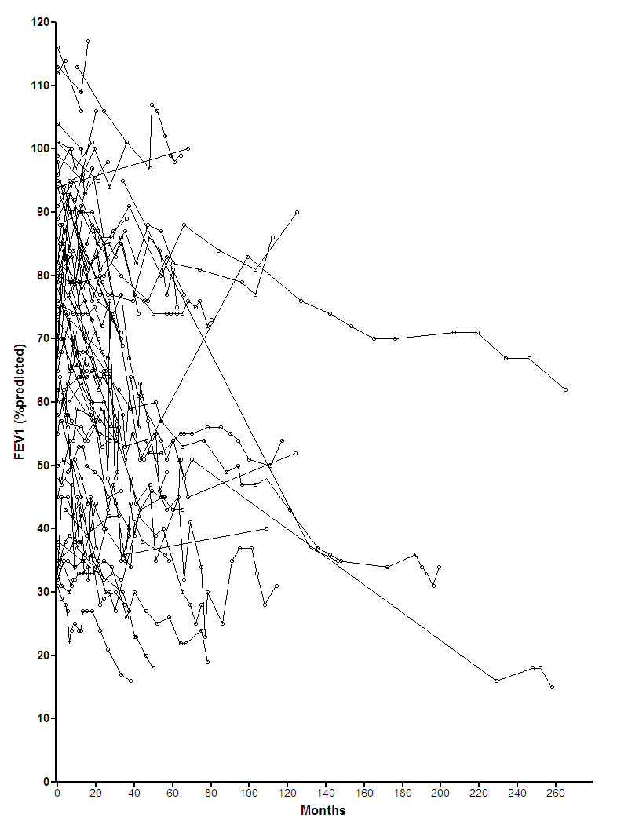
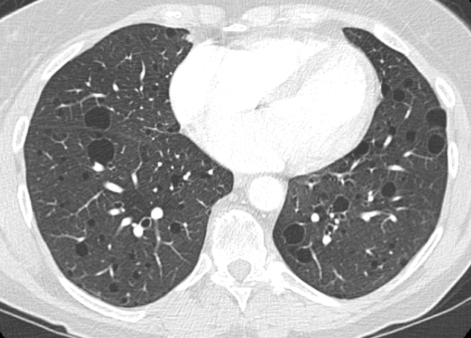
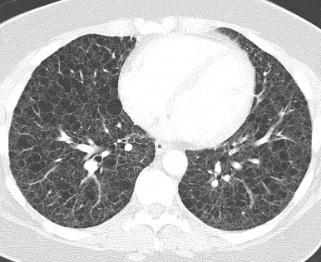
Not everyone needs an mTORi
FEV₁ (% predicted)
0 40 80 120 160 200 240 280
months since 1st evaluation

Slide 18
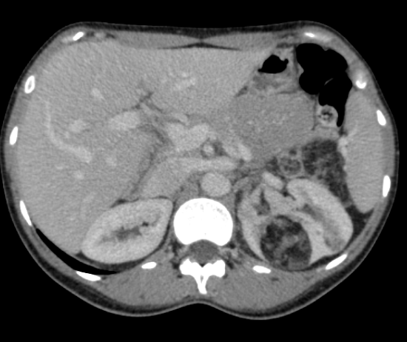
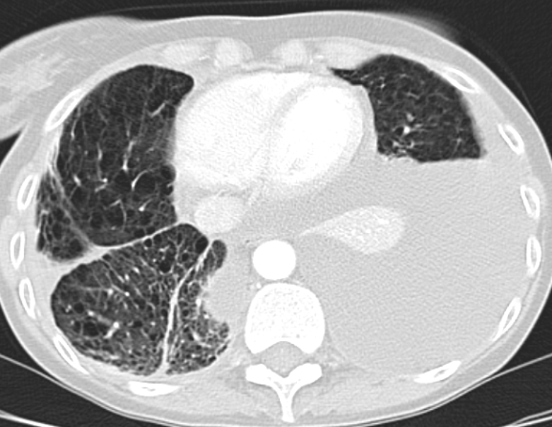
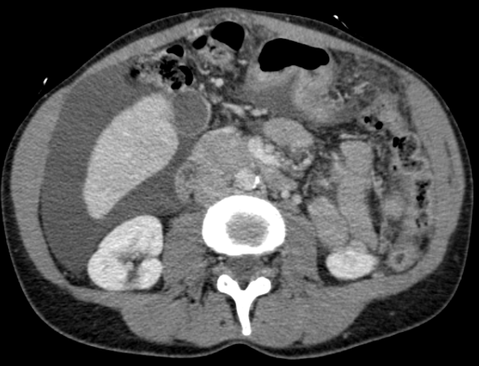
What about mTORi and other manifestations of LAM?
angiomyolipoma
chylous effusion
chylous ascites

Slide 19
What happens as time passes?
no mTOR inhibitor
mTOR inhibitor
no mTORi
ΔFEV₁ -70 ml/year (n=66)
mTORi
ΔFEV₁ -7 ml/year (n=23)
FEV₁ (l)
Bee et al. Thorax 2015

Slide 20
Who should take mTORi for LAM?
need treatment
  rapid lung function decline
  chylous problems,
  complex angiomyolipoma
  other TS related problems
understand the risks
  have someone to prescribe & monitor
is there a trial to enter?

Slide 21

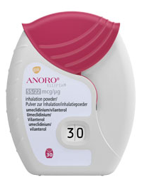
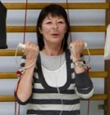
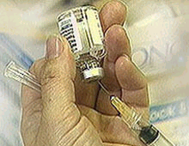

What can I do to help myself?
Advice
  pneumothorax
  angiomyolipoma
  infections / vaccinations
  pregnancy
Bronchodilators
Pulmonary rehab
Patient support
Oestrogen
  no HRT
  no combined contraceptive pill
Smoking

Slide 22
Other ‘dos and don’ts’
Don’t let chest infections drag on
Do see your doctor urgently or go to A&E if you have significant chest or flank pain
Do discuss pregnancy with your physician before pregnancy

Slide 23
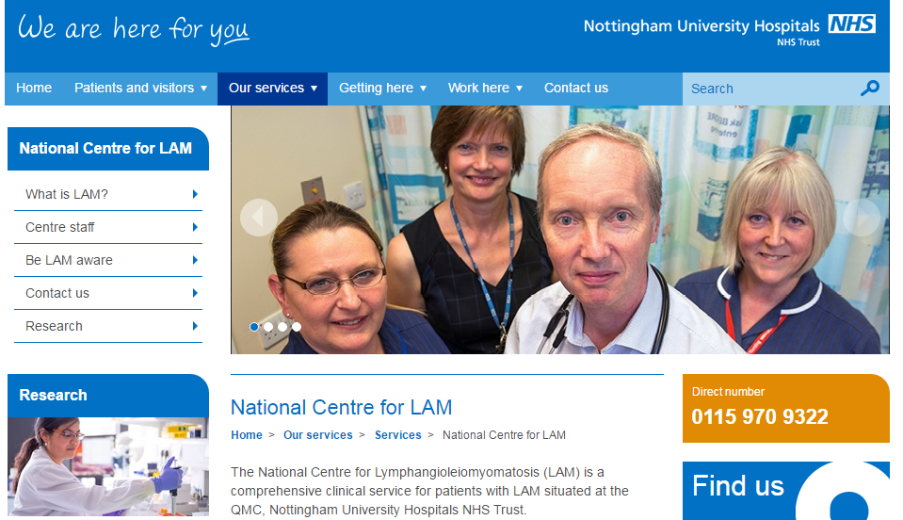
UK LAM centre: Nottingham
Genetics
Urology
Respiratory medicine
Thoracic surgery
Transplant
Local services

Slide 24
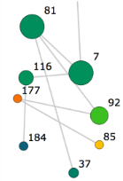
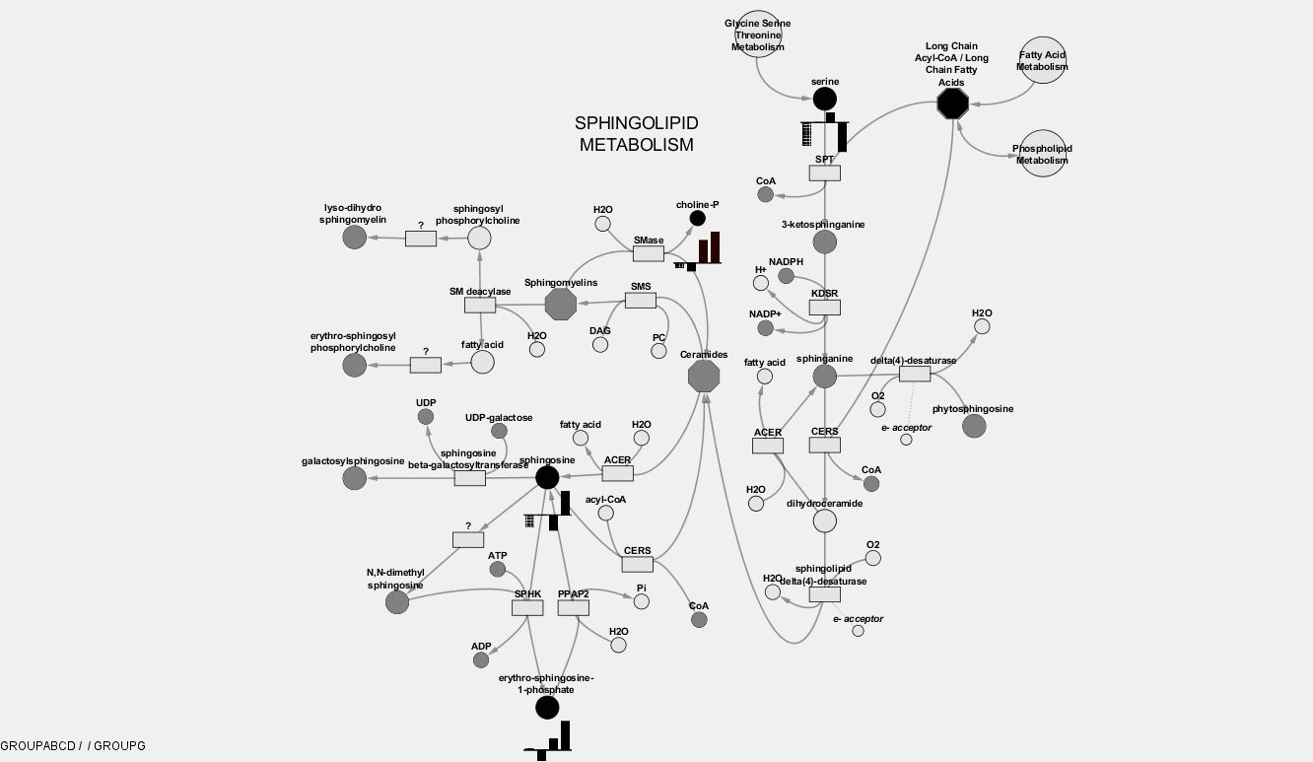
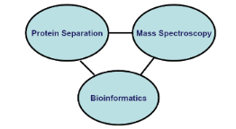

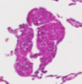
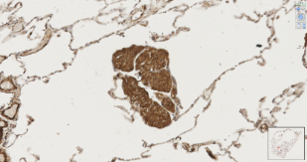
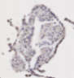
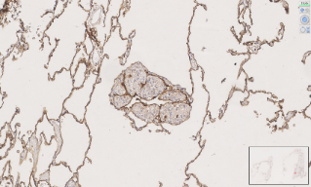
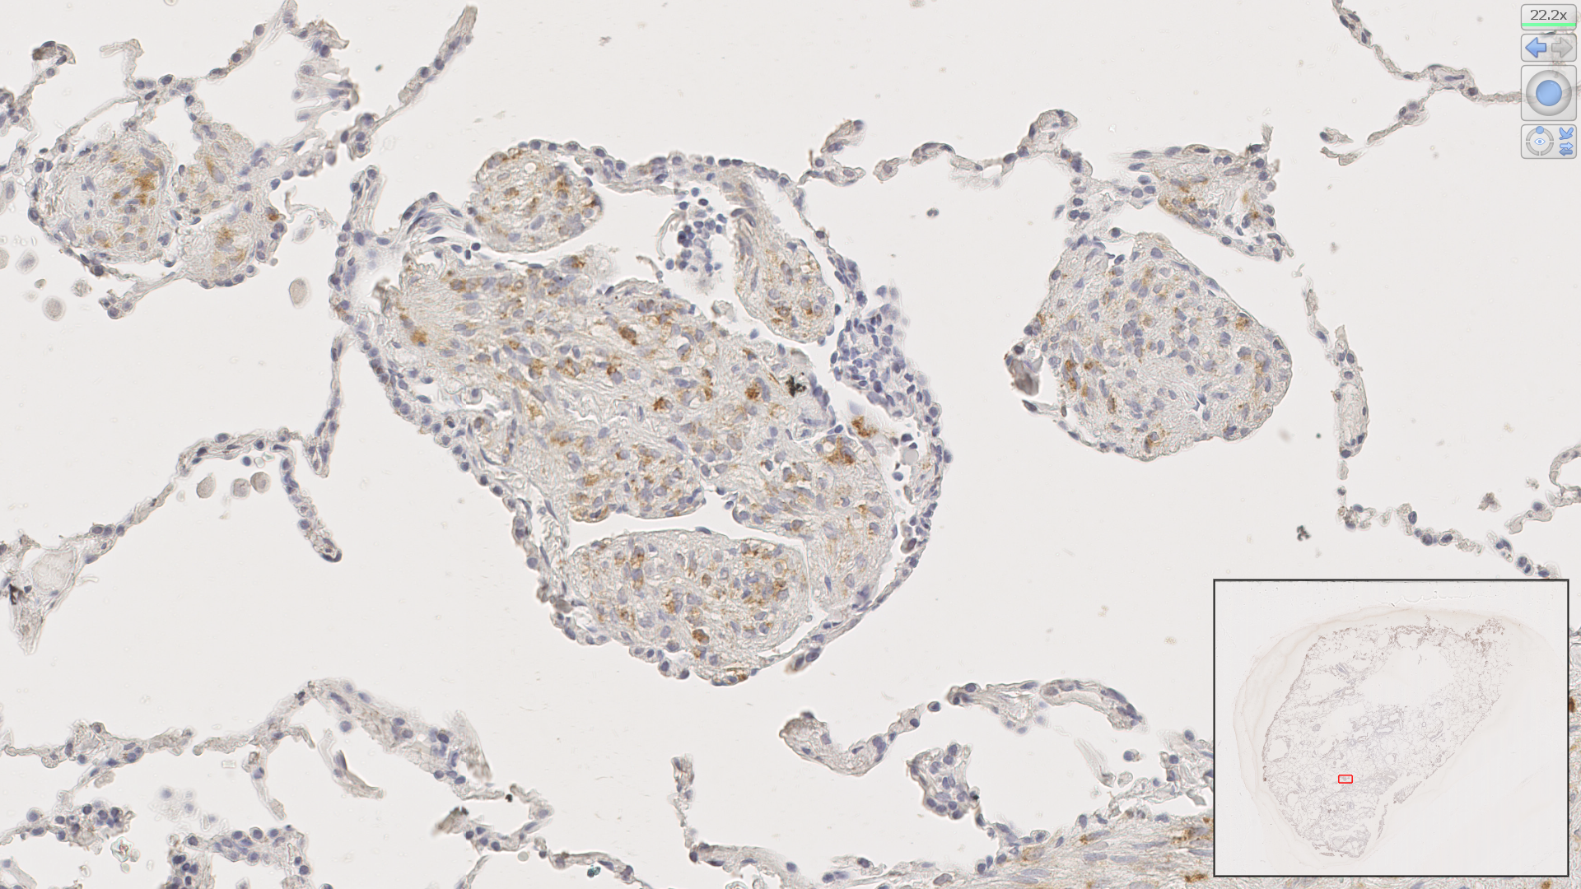
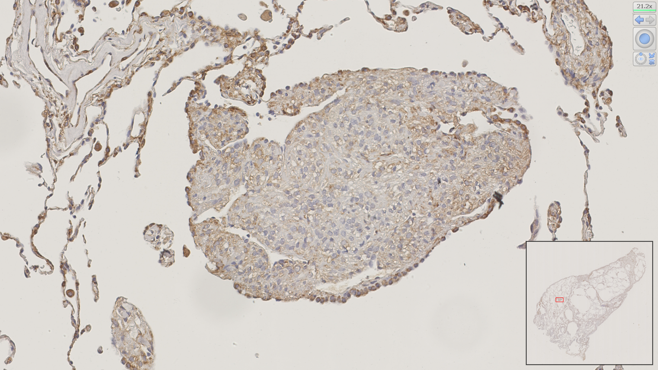

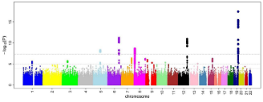
Prospective UK LAM cohort study
Phenotyping and outcome
UK LAM centre
Baseline
phenotyping
Prospective
assessment
ΔFEV₁ (ml/yr)
Metabolomics
Genetics
Urology
Clinical assessment
Imaging
Clinical phenotyping
Lung function
Quality of life
Serum
DNA
Clinical tissue
Clinical outcome
(need for therapy)
(transplant / death)
Lung function trajectory
Respiratory medicine
Proteomics
Thoracic surgery
replication / collaboration
Transplant
consent
Histology & laboratory work
H&E
αSMA
FSP
Local services
podoplanin
PNL2
phospho S6
200 / 300 UK women with LAM
NHS England
Highly specialised commissioning
Genetics
Biomarkers
Prognostic markers
Laboratory work
how active is my LAM?
what complication will I get?
how are the lungs dmaged?
what is my prognosis?
do I need treatment?
how can we prevent this?

Slide 25




Thankyou and any questions?
Women with LAM
LAM research group
Debbie Clements
Suzanne Miller
Roya Babaei-Jadidi
Jan Johnson
LAM Centre
Sharon Fuller
Hollie Gorensweigh
Wendy Somerfield
Lucy Davies
LAMcentre@nuh.nhs.uk

