Slide 1

How recent research informs new UK guidelines for TSC
Prof Julian Sampson (Head of the Institute of Medical Genetics, Cardiff University)
Dr Chris Kingswood (Consultant Nephrologist, St George’s University Hospital)

Slide 2
Current Research and
New Treatment Guidelines for Tuberous Sclerosis
Prof Julian Sampson (Head of the Institute of Medical Genetics, Cardiff University)

Slide 3
This talk…..
New research into treatments for TSC
Treatment guidelines – new ones for the UK and plans to update the American-led International Guidelines

Slide 4
Researching Better Treatment for TSC
New drugs under investigation
e.g. REF1 and STAT3 inhibitors
Approved drugs, but new for TSC (“repositioning”)
e.g. GWP42003 (CBD)
  TSC epilepsy trial
  TSC tumours pre-clinical
New indications for current TSC treatments
e.g. Everolimus for psychological aspects of TSC

Slide 5
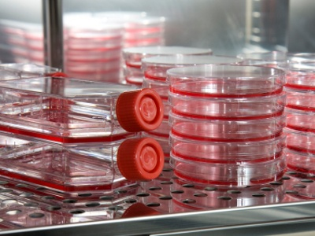
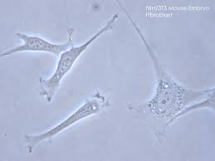
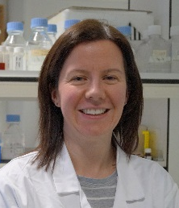
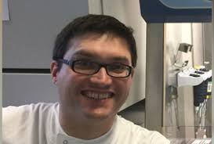
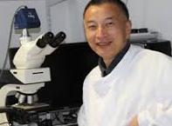

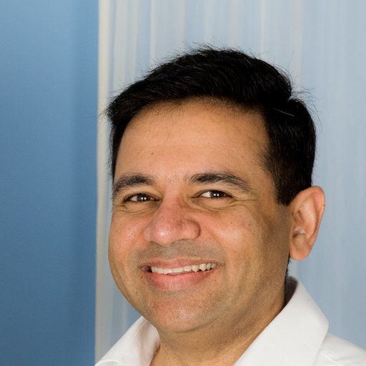
Researching Better Treatment for TSC
Cells
Mice
People
Elaine
Dunlop
Andy
Tee
Ming Shen
Anurag Saxena

Slide 6

Testing New Drugs in Cells and Mice
Drugs acting “down stream” of mTOR
STAT3 and REF-1 inhibitors block TSC tumour growth
Combination treatments to kill TSC tumour cells
(e.g. nelfinavir−bortezomib, published 2018)
Andy Tee
Ming Shen

Slide 7

Repositioning CBD for TSC Tumours?
Cannabidiol (CBD) Treating TSC tumour cells and TSC tumours in mice
CBD blocks development of blood vessels in TSC tumours
Andy Tee

Slide 8
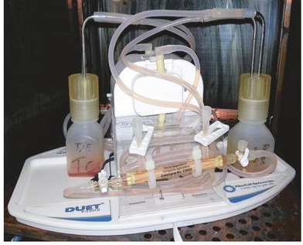
Modelling LAM Cell Behaviour
In LAM TSC-null cells migrate to the lung and cause gradual cystic destruction
Can we model this and then prevent it?

Slide 9
CDB for Epilepsy in TSC
Clinical trial completed
Publication of results awaited
If results are positive a license application, then NHS commissioning will be required
Anurag Saxena

Slide 10
Everolimus (Votubia) for Psychological Problems in TSC
Everolimus for treatment of tuberous sclerosis complex-associated
neuropsychiatric disorders
Darcy Krueger et al. (Cincinnati and Boston), Ann Clin Transl Neurol, Nov 2017
47 6 – 21 year olds treated with Everolimus or Placebo for 6 months
No significant differences seen (after correction for multiple testing)
2. A Randomized controlled trial with everolimus for IQ and autism in
tuberous sclerosis complex
Iris Overwater et al. (Rotterdam and Utrecht), Neurology, July 2019
32 children with TSC aged 4 to 17 years treated for 12 months
No effect of Everolimus on IQ or autism

Slide 11
3. TRON Trial of Everolimus for Neurocognitive Problems in TSC
38 Adults aged 16 – 60
randomised 2:1 everolimus vs placebo for 6 months
Tested memory and executive function (thinking)
Anurag Saxena
RESULTS:
Improvement (>1SD) after 6 months of treatment:
Placebo 44%; Everolimus 70%

Slide 12
Why we should be optimistic about researching treatments for TSC!
Common Condition (e.g. breast cancer)
Genetic Condition
(e.g. tuberous sclerosis)
Apparently single condition
SingleGene
Targeted Treatment
Personalised Medicine
Reality: Many Different Types
Multiple Different Complications

Slide 13
What Next for Research on Treatment?
Big (phase 3) trials of mTORi for neurocognitive and neurodevelopmental problems in TSC
Prevention trials – in the very young
Trials of treatments to CURE rather than control TSC tumours

Slide 14
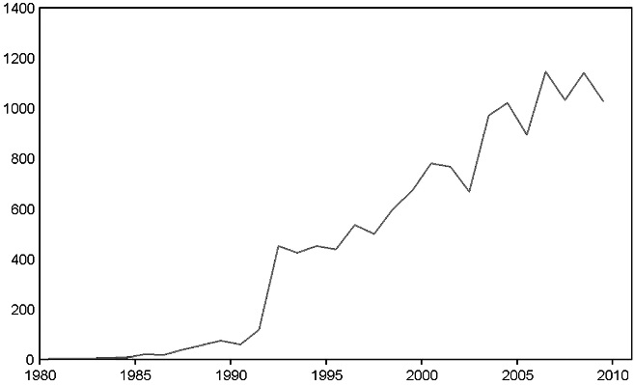
Clinical Guidelines
Why have clinical guidelines?
To assist doctors & patients in achieving best care
Quality of available evidence
Category 1. Randomized control trials
Category 2. Other research studies
Category 3. Expert opinion

Slide 15
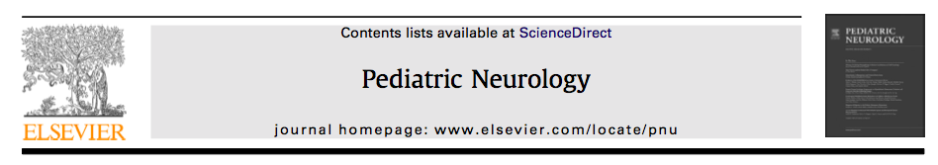
Treatment recommendations for:
SEGA (mTORi or surgery)
Kidney AML (mTORi)
LAM (mTORi)

Slide 16
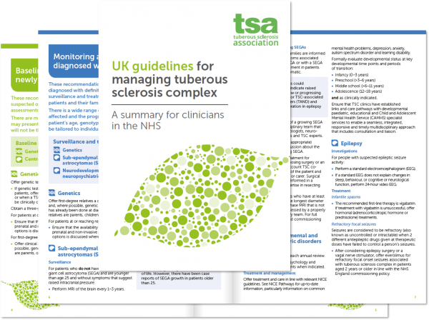
UK Guidelines 2019
Dr Sam Amin (Bristol)
mTOR inhibitor only in specific situations for SEGA
(surgery is first line)
mTOR inhibitor first line for kidney AML (unless bleeding)
mTOR inhibitor for progressive LAM
Also published, 2019, in a peer reviewed medical journal (QJM)

Slide 17
Summary
Research into better treatments involves lab scientists, pharma companies and clinical researchers working together with people with TSC and the TSA
It is an international effort
It is highly regulated and administratively slow
High quality clinical research best informs consensus guidelines to benefit patients

Slide 18
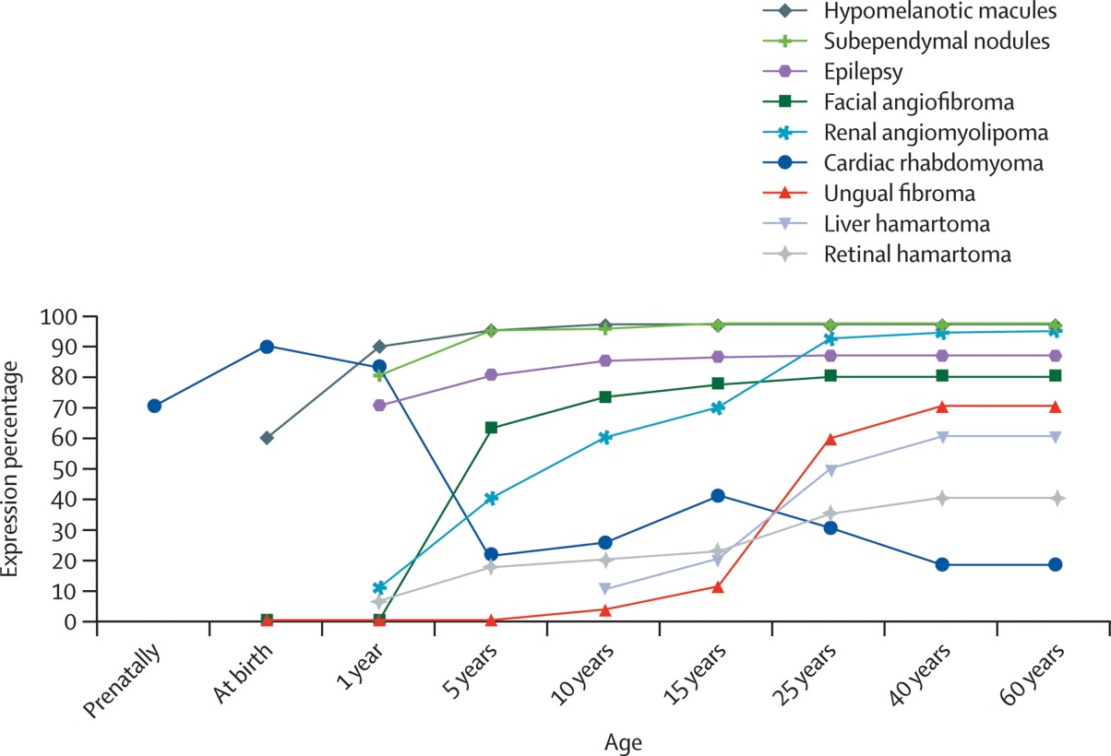
Natural history of TSC
Advert! Genes and the kidney in TSC
Curatolo et al. Lancet 2008

Slide 19
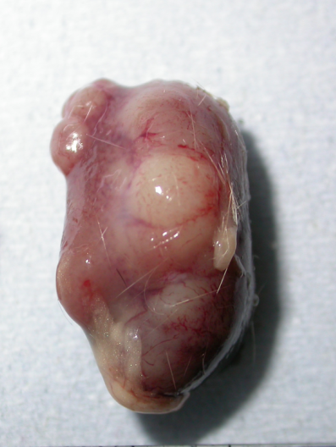
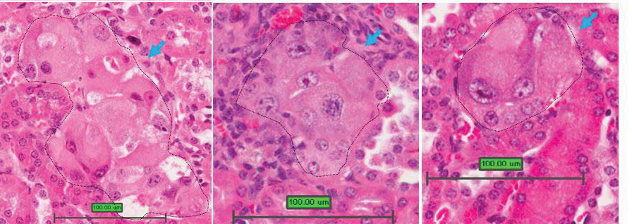
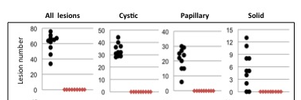
Prevention of TSC in a Transgenic Mouse Model:
Yang et al.
Oncogene 2015
“Placebo”
Rapamycin

Slide 20
TSC research timeline
mTOR
inhibitors
in mouse models
Phase III
mTOR inhibitors
For epilepsy
Phase II
mTOR inhibitors
TSC1
Rheb
mTOR
TSC2
1993
1997
2003
2008
2012
2016
Everolimus
Licenses
Phase III
mTOR inhibitors
For TSC Tumours

Slide 21
TSC Research
Dr Chris Kingswood (Consultant Nephrologist, St George’s University Hospital)

Slide 22
Research Update
Epilepsy & TAND
  Epistop and PREveNT (S Jozwiak & M Bebin)
  Exist-3
  Cannabidiol (R Thiele & A Tee)
LAM & Kidneys
  Tumour microenvironment (E Henske)
  Variability response in LAM (R Kristof)
Other treatments
  Protective pathways and drugs

Slide 23
Research Update
Various
  Sleep disorders (A Peron) & Circadian rhythm (J Lipton)
  Animal models, stem cells and organoids
Early Prediction
  P Bolton, M Sahin, S Jeste, J Capel

Slide 24
What Next?
STOP Studies – Prevention not rescue
Beyond Epistop
TANDEM
New Medications
Delivery – Do what we know how to well

Slide 25


UK International TSC Research Conference
November 2020
Register for the mailing list by emailing admin@tuberous-sclerosis.org

